Slide 1

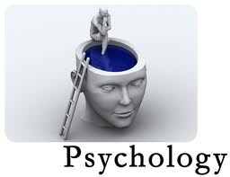

Slide 2

Psychology is scientific study of behavior and mental processes.
What is a science?
Observation,description,explaination and prediction of behavior through systematic methodology.

Slide 3

BIOLOGICAL:
Biological perspective is the scientific study
of the biological bases of behavior and
mental states, very closely related to
neuroscience.
2. The psychoanalytic perspective:
The psychoanalytic perspective originated
with the work of Sigmund Freud. This perspective
emphasizes the role of the unconscious mind,
early childhood experiences, and interpersonal
relationships to explain human behavior and to
treat people suffering from mental illnesses.

Slide 4
3. Behavioral Perspective:
Behavioral psychology is a perspective that focuses on learned behaviors. Today, the behavioral perspective is still concerned with how behaviors are learned and reinforced.
John Watson founded behaviorism in the early 1900's. Watson emphasized the scientific study of observable behaviors rather then the study of subjective mental process.

Slide 5
4. Humanistic Perspective:
During the 1950s, a school of thought known as humanistic psychology emerged. Influenced greatly by the work of prominent humanists such as Carl Rogers and Abraham Maslow, this perspective emphasizes the role of motivation on thought and behavior.
5. Cognitive Perspective:
During the 1960s, a new perspective known as cognitive psychology began to take hold. This area of psychology focuses on mental processes such as memory, thinking, problem solving, language and decision-making.

Slide 6
6. Social cultural Perspective:
The sociocultural perspective maintains that behavior and mental processes are shaped not only by prior learning experiences (the behavioral perspective) or intra-psychic forces (for instance, the unconscious) but also by the social or cultural context.

Slide 7

Structuralism:
Structuralism was the first school of psychology and focused on breaking down mental processes into the most basic components. Researchers tried to understand the basic elements of consciousness using a method known as introspection. Wilhelm Wundt, founder of the first psychology lab, was an advocate of this position and is often considered the founder of structuralism, despite the fact that it was his student, Edward Titchener who first coined the term to describe this school of thought.

Slide 8
2. Functionalism:
Developed by William James Functionalism is an early approach to psychology that concerned with what the mind does-the functions of mental activity-and the role of behavior in allowing people to adapt to their environment.

Slide 9
3. Gestalt Psychology:
Gestalt psychology is a school of thought that looks at the human mind and behavior as a whole. Originating in the work of Max Wertheimer, Gestalt psychology formed partially as a response to the structuralism of Wilhelm Wundt. The development of this area of psychology was influenced by a number of thinkers, including Immanuel Kant,Kurt Koffka and Johann Wolfgang Kholer.

Slide 10
4. Psychodynamic Model:
The approach based on the belief that behavior is motivated by unconscious inner forces over which the individual has little control.
Key features of the Psychodynamic approach are:
Our behavior and feelings as adults are rooted in our childhood
experiences.
  Relationships (particularly parenting) are of primary importance in
  determining how we feel and behave.
  Our behavior and feelings are powerfully affected by the meaning of
  events to the unconscious mind.
  Information can be obtained from dreams, irrational behavior and
  what patients in therapy say.
  The personality is made up of three distinct structures: id, ego and
  super ego.
  Defense mechanisms are used to protect the ego, e.g. repression.
  Children develop through a series of fixed stages: oral, anal and
  phallic.

Slide 11
5. Humanistic Model:
Developed by Rogers and Maslow in the 1950s
Assumptions:
A healthy mental attitude is dependent on taking personal responsibility, recognizing the existence of free will, and striving towards personal growth and fulfillment.
Individuals have a need for self actualization.
People are naturally good, with the potential for personal growth if they are provided with the appropriate circumstances.
Rogers (1959): if in early life children receive unconditional positive regard they will develop satisfactorily. However, if they experience conditions of worth, they are prevented from realizing their potential and becoming self-actualised.
People use distorted thinking to defend themselves, e.g., by rationalization, that is distorting their real motives to fit in with their self-concept.

Slide 12
6. Behaviorism:
The approach that suggests that observable behavior should be the focus.
This perspective views behavior (except for genetically determined behavior) as the result of environmental experience! Environmental experience (also called learning) is the sum total of all life experiences that the individual has been subjected to in the past and to the new experiences that will influence on his or her behavior.According to B.F Skinner behavior depends on S-O-R.

Slide 13
7. Cognitive Model:
Studies mental processes including how people think, perceive, remember and learn. As part of the larger field of cognitive science, this branch of psychology is related to other disciplines including neuroscience, philosophy, and linguistics.

Slide 14

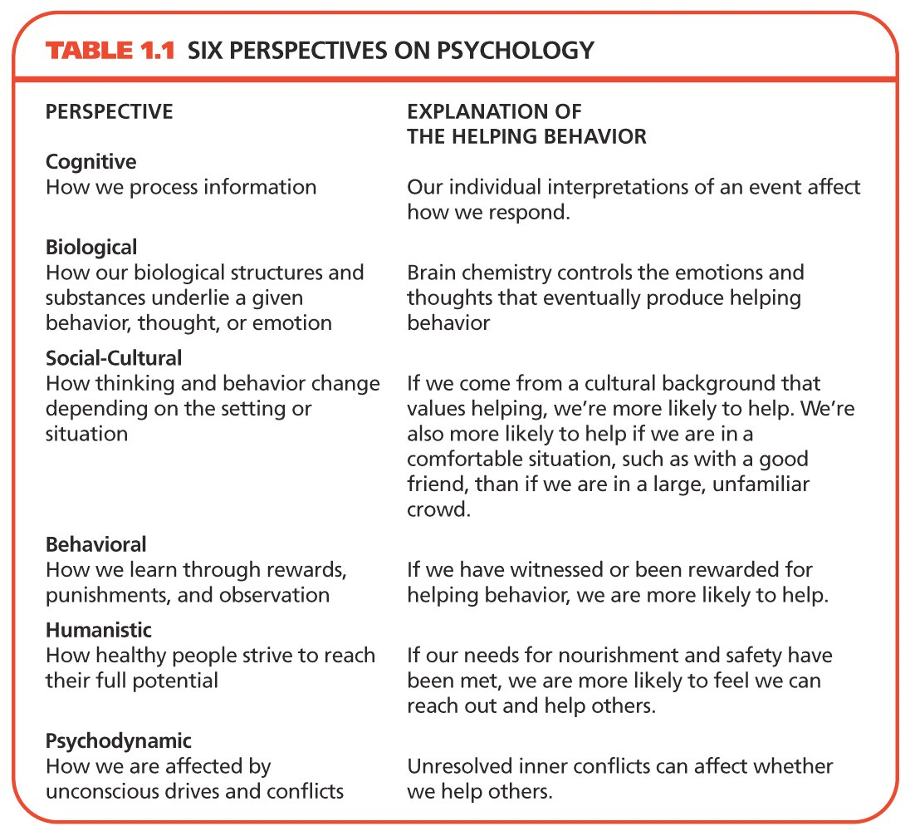

Slide 15

Experimental Psychology:
a general title applied to a variety of psychologists who are trained in designing and conducting research in specific basic areas like learning, sensation and perception, human performance, and motivation and emotion. A research oriented doctoral degree (Ph.D.) is usually needed.

Slide 16
2. Biopsychology:
Take a comparative and genetic perspective in the experimental analysis of basic psychological processes as they relate to the many ways in which animal species adapt, survive, reproduce and evolve.

Slide 17
3. Developmental Psychology:
Concerned with growth and development from conception till death. All aspects of the animal or human organism (physiological, biological, physical, cognitive, emotional, social, cultural) may be studied.

Slide 18
4. Social Psychology:
study the ways in which the social context affects the behavior of the individual and groups in the real world and the laboratory. Social psychologists focus on topics such as social roles, attitude formation and change, affiliation, interpersonal attraction and interaction, conformity, and group processes.

Slide 19
5. Industrial / Organizational Psychologists:
Study the relation between individuals and work. They are employed in business and industry, in government, and in colleges and universities, and may perform a variety of jobs. An industrial/organizational psychologist working in industry may study how work is organized; suggest changes to improve the satisfaction of employees, the quality of the organization's services, and productivity; consult with management on the development of effective training programs for employees; design programs for the early identification of management potential; administer career counseling and pre retirement counseling programs; develop affirmative action programs; recommend changes in job definition; design a system of performance evaluation.

Slide 20
6. Educational Psychologists:
Are concerned with a range of activities from initial design through development and evaluation of both materials and procedures for education and training. Such positions exist in public schools, in the military, in private research and development companies, and in industrial concerns. They may deal with analyzing education and training needs, with developing materials for instruction in various media, with designing the best conditions for instruction, and with evaluating the effectiveness of instructional programs.

Slide 21
7. Clinical Psychology:
We are concerned with the diagnosis and treatment of psychological disturbances. Their responsibilities range from administering and scoring psychological tests, to engaging in therapy, to supervising the training of graduate students in the delivery of mental health services, to administering a community mental health program. Some clinical psychologists obtain faculty positions in a college or university some serve as consultants or as therapists.

Slide 22
8. Counseling Psychology:
We are concerned with counseling, teaching, consulting research, and/or administration. In this we are particularly concerned with the role of education and work in an individual's functioning, and with the interaction between individuals and the environments in which they live. Typically, counseling psychologists work with normal or moderately maladjusted persons, individually or in groups. This work includes use of traditional counseling interview methods, interest, ability and personality tests, and educational and occupational information.

Slide 23
9. Cross-cultural psychology
Is a branch of psychology that looks at how cultural factors influence human behavior. They study whether behavior is culture-universal or culture-specific.
10. Forensic Psychology:
It is defined as an intersection between psychology and the criminal justice system. Forensic psychologist work in legal area assisting in jury selection, evaluating disability claims. and providing expert testimony during court trials.

Slide 24
11. Environmental psychology:
Is an interdisciplinary field focused on the interplay between humans and their surroundings. The field defines the term environment very broadly including all that is natural on the planet as well as social settings, built environments, learning environments and informational environments.

Slide 25
12. Psychiatry:
Psychiatry is a branch of medicine practiced by physicians with an M.D degree who specialize in abnormal psychology and therapy. The difference between clinical psychologist and psychiatrist is they can prescribe medicines, whereas clinical psychologist cannot.

Slide 26
13. Psychology of Women
This class explores the female experience within the world. Many times people ask why there isn't a Psychology of Men class. There are plenty of them, as most classes are designed with the male as the baseline. This class looks at how women differ from the baseline and how the female experience is also valid in its own right, not as just an "other."

Slide 27


Slide 28

All methods or tests used by researchers and psychometricians should be
Valid. Reliable Standardized.
To describe, predict, and explain behavior and mental processes, psychologists use three basic methods:
Description(case studies, surveys, and naturalistic observations)
Correlation
Experimentation

Slide 29
1. CASE HISTORY:
An in-depth study of one person. In a case study, nearly every aspect of the subject’s life and history is analyzed to seek patterns and causes for behavior. The hope is that learning gained from studying one case can be generalized to many others. Unfortunately, case studies tend to be highly subjective. We use
Child book, Biographical and clinical method

Slide 30
2. NATURALISTIC OBSERVATION:
Naturalistic observation is a method of observation, commonly used by psychologists, behavioral scientists and social scientists, that involves observing subjects in their natural habitats. Researchers take great care in avoiding making interferences with the behavior they are observing by using unobtrusive methods. Objectively, studying events as they occur naturally, without intervention.

Slide 31
3. SURVEY METHOD:
Survey is a method of scientific investigation in which a large sample of people answer questions about their attitudes or behavior.

Slide 32
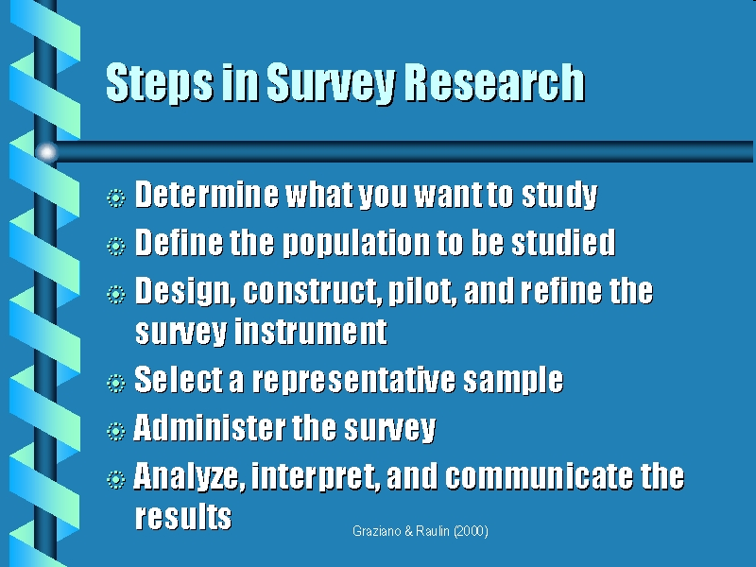

Slide 33
4. EXPERIMENTAL METHOD:
The experimental method involves manipulating one variable to determine if changes in one variable cause changes in another variable. This method relies on controlled methods, random assignment and the manipulation of variables to test a hypothesis.
An experiment is a study of cause and effect. It differs from non-experimental methods in that it involves the deliberate manipulation of one variable, while trying to keep all other variables constant.

Slide 34
Parts of a Simple Experiment:
Problem: Select a solvable problem
The experimental hypothesis: a statement that predicts that the treatment will cause an effect. The experimental hypothesis will always be phrased as a cause-and-effect statement.
The independent variable: the treatment variable that is manipulated by the experimenter.
(stimulus)
The dependent variable: the response that the experimenter is measuring. (response)
The control group: made up of individuals who are randomly assigned to a group but do not receive the treatment. The measures takes from the control group are then compared to those in the experimental group to determine if the treatment had an effect.
The experimental group: made up of individuals who are randomly assigned to the group and then receive the treatment. The scores of these participants are compared to those in the control group to determine if the treatment had an effect.

Slide 35
Example:
Hypothesis: an aspirin a day reduces the likelihood of a heart attack.
Independent variable: Aspirin
Dependent Variable: the number of heart attacks.
The experimental group: would take an aspirin each day
The control group: would take a placebo, such as a sugar pill, that resembles an aspirin but has none of the effects attributed to aspirin.
After a few months or years of pill-taking, the number of heart attacks would be measured as the dependent variable. If the aspirin-takers (experimental group) had a significantly smaller number of heart attacks than the placebo-takers (control group), then the research hypothesis (aspirin-taking reduces heart attacks) would be supported.

Slide 36
5. CORRELATION:
Correlation studies are used to look for relationships between variables. There are three possible results of a co relational study: a positive correlation, a negative correlation, and no correlation. The correlation coefficient is a measure of correlation strength and can range from –1.00 to +1.00.
Positive Correlations: Both variables increase or decrease at the same time. A correlation coefficient close to +1.00 indicates a strong positive correlation.
Negative Correlations: Indicates that as the amount of one variable increases, the other decreases (and vice versa). A correlation coefficient close to -1.00 indicates a strong negative correlation.

Slide 37


Slide 38

Each individual scientist has an ethical responsibility to seek knowledge and to strive to improve the quality of life. Scientists should:
Carry out research in a competent manner;
Report results accurately;
Manage research resources honestly;
Fairly acknowledge, in scientific communications, the individuals who have contributed their ideas or their time and effort;

Slide 39

Planning Research
Responsibility
Compliance with law and standards
Institutional Approval
Judging benefit and cost
Informed consent
Debriefing
Plagiarism & self plagiarism
Reporting the results.

